Slide 1
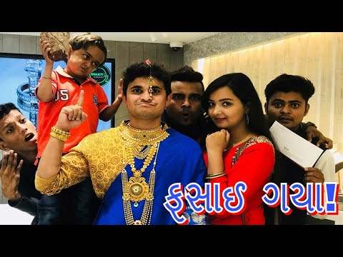
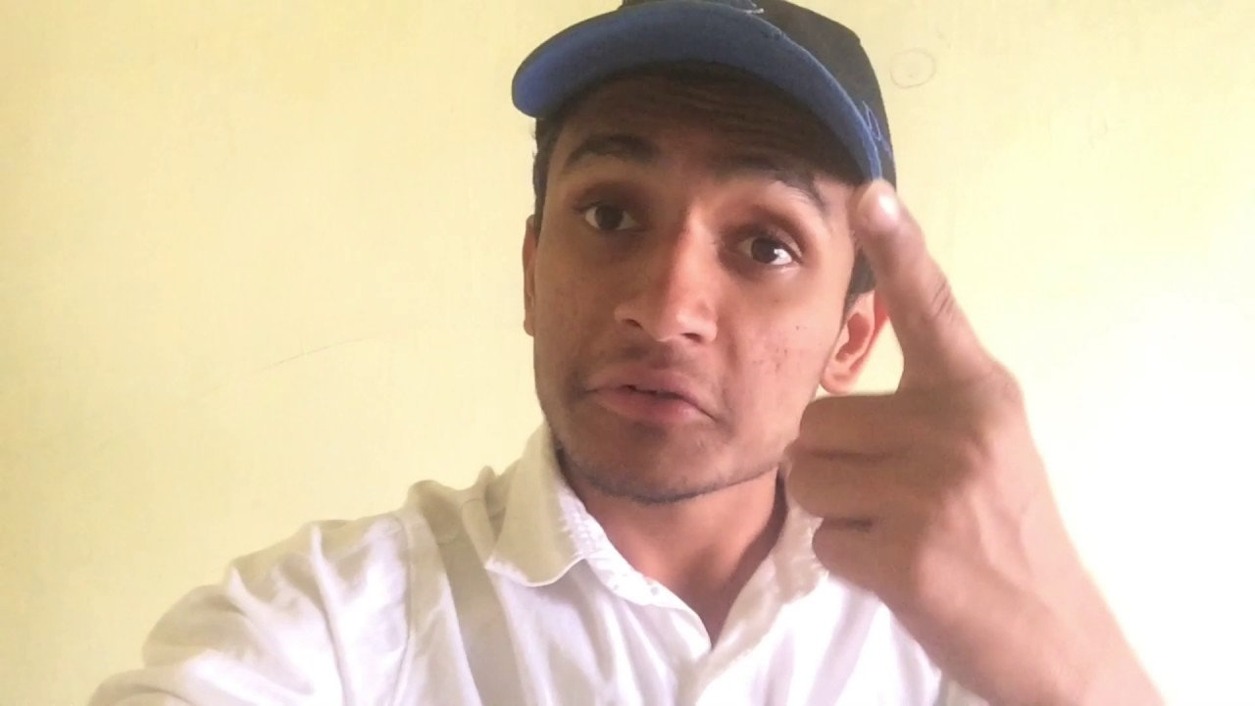
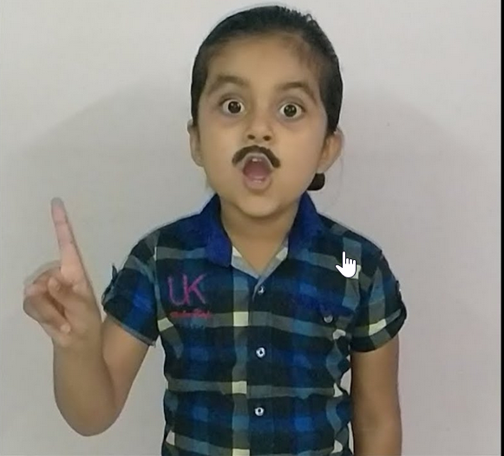
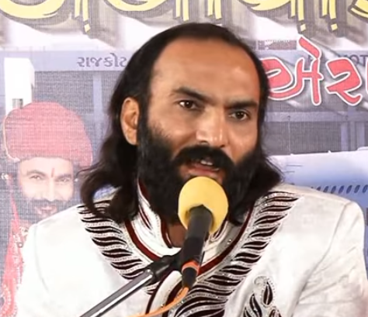

Slide 2

ગુજરાતી HD વિડિઓ
2018

Slide 3

ગુજરાતી HD વિડિઓ
2018

Slide 4

Kinjal Dave Video Songs

Slide 5
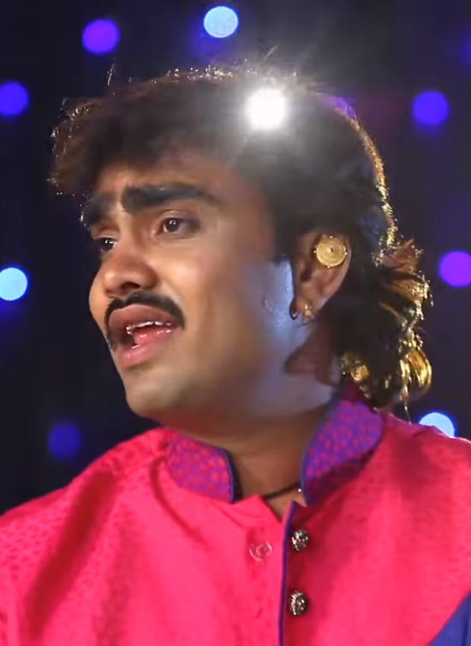
Jignesh Kaviraj Video Songs

Slide 6
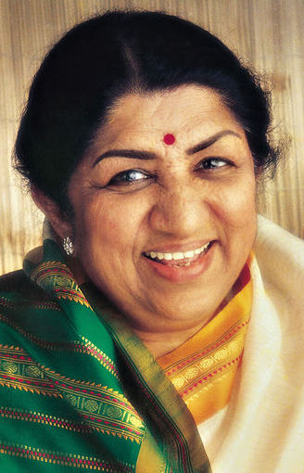
Lata Mangeshkar Old Songs

Slide 7
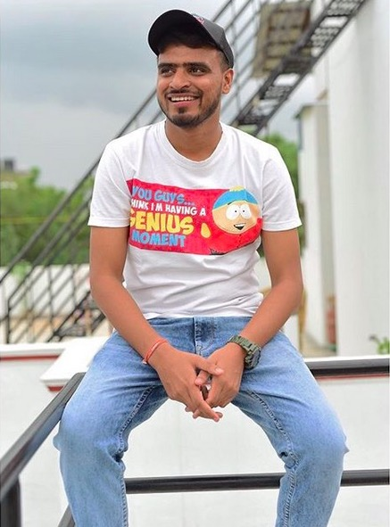

Slide 8
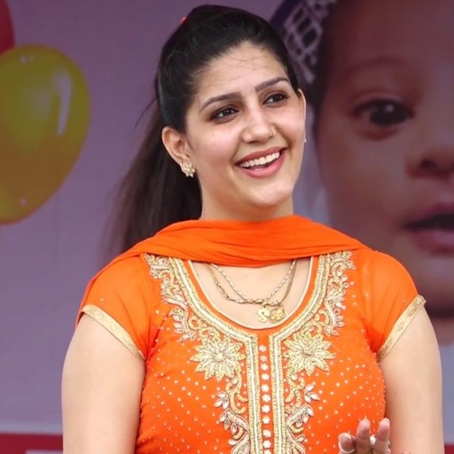

Slide 9


Slide 10


Slide 11

Luccas Neto

Slide 12

Sagar Patel Video Songs

Slide 13

HD VIDEO SONGS 2018
કિંજલ દવે

Slide 14
HD Video
સાગર પટેલ

Slide 16

સાગર પટેલ ની મોજ

Slide 17
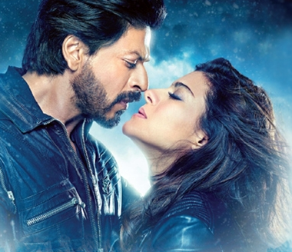
Top Hindi
Songs 2018

Slide 18
Top Hindi
Songs 2018

Slide 19

Top Hindi
Songs 2018

Slide 20


Slide 21


Slide 22
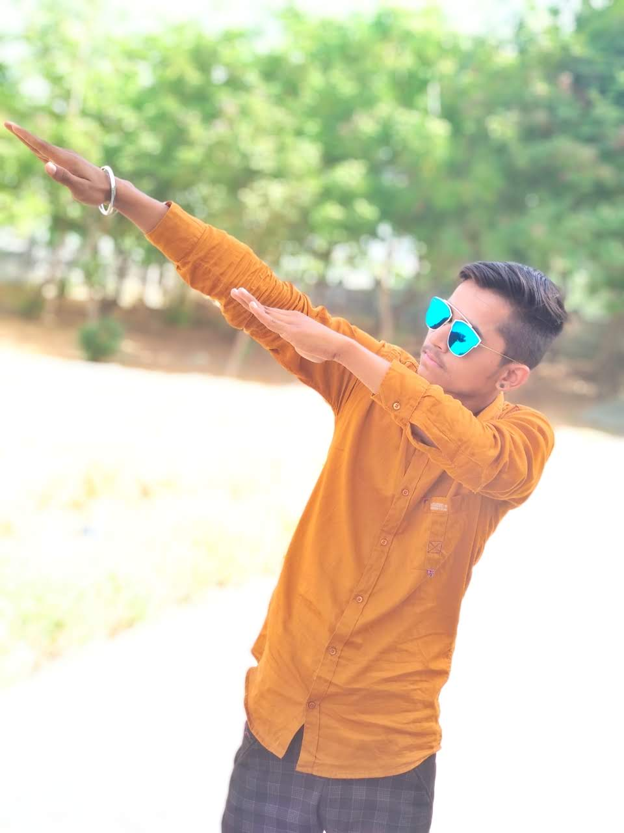
Rutvik Patel – Royal Status

Slide 23
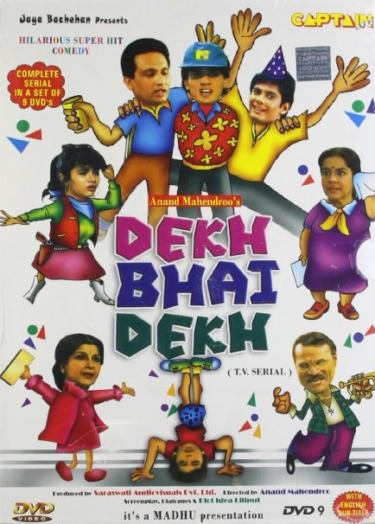

Slide 24
Rutvik Patel – Royal Status

Slide 25
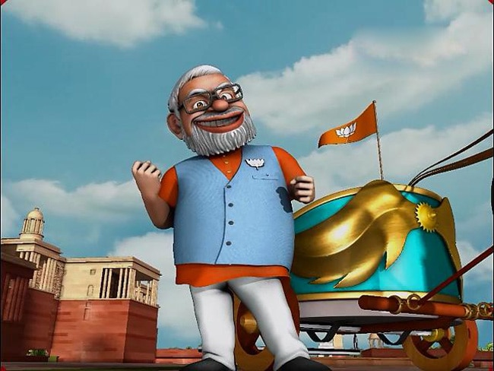
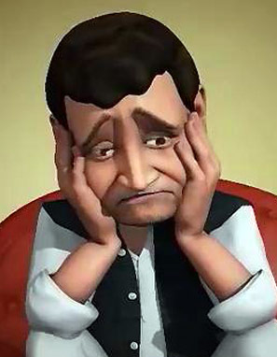
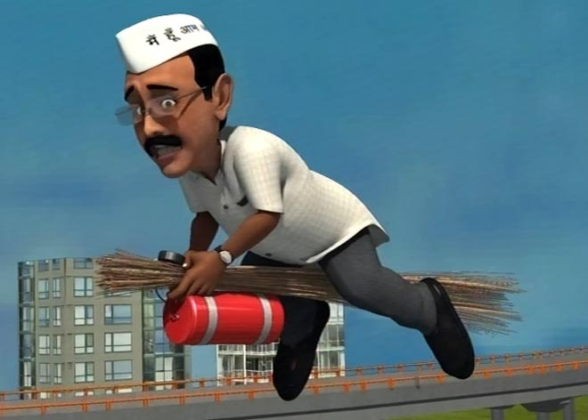
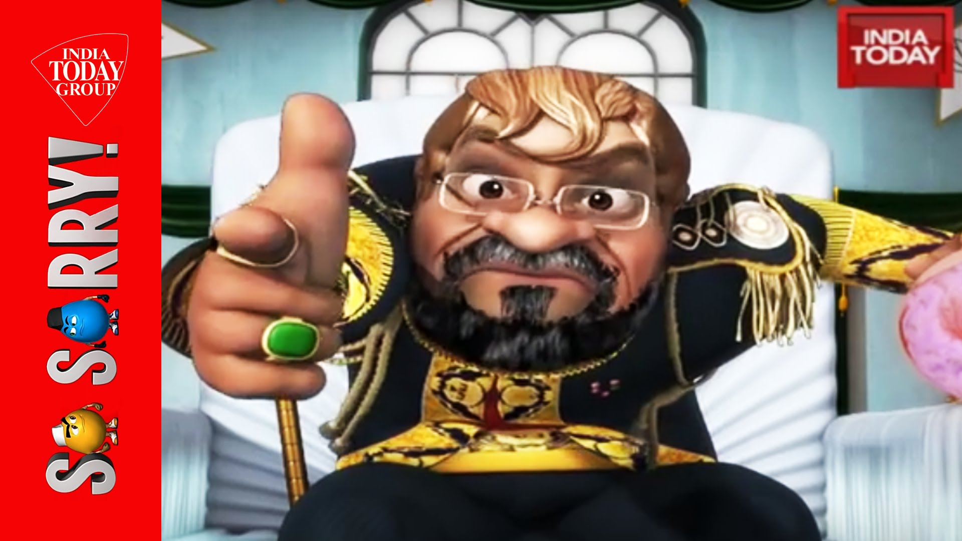
So Sorry

Slide 26

So Sorry Comedy Videos

Slide 27
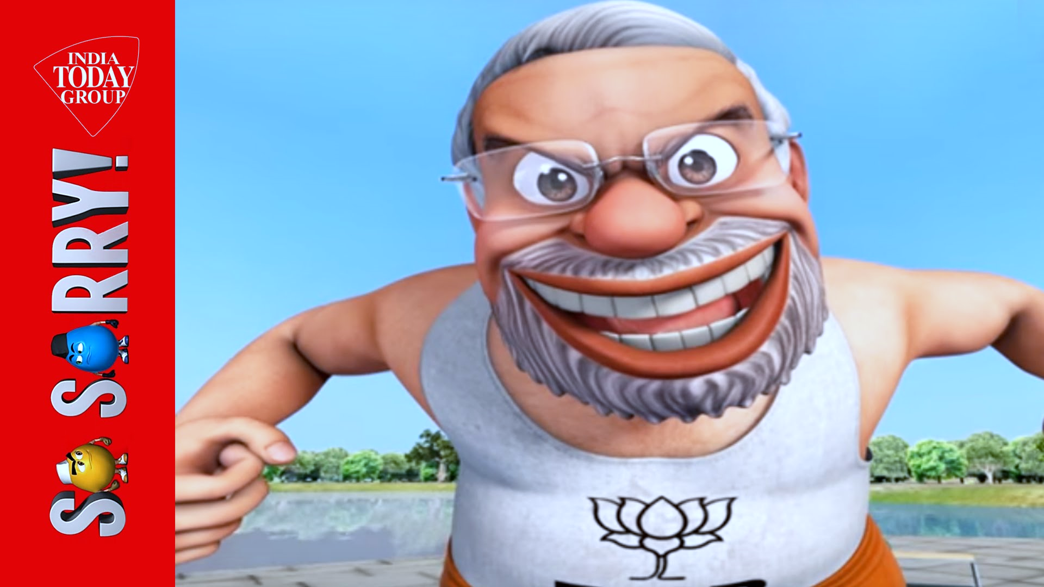


Slide 28
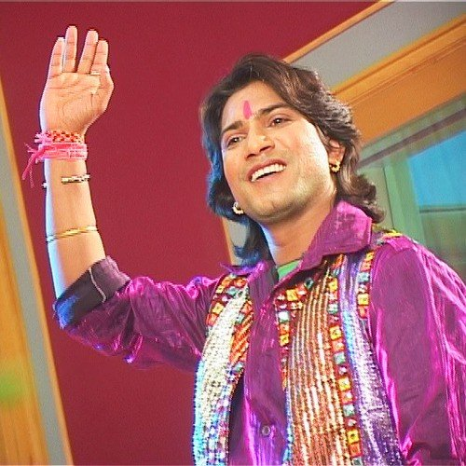
V
T
Vikram Thakor

Slide 29

V
T
Mamta Soni

Slide 31

Haryanvi Comedy Videos

Slide 32
Gujarati HD Videos

Slide 33
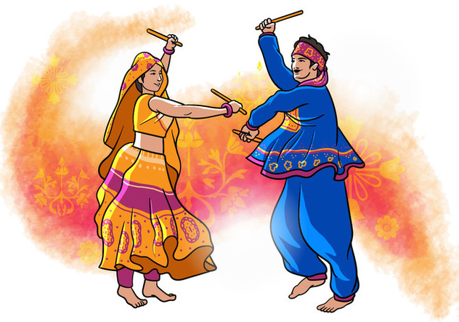
Navratri Garba

Slide 34
Awesome Hindi Videos

